Slide 1
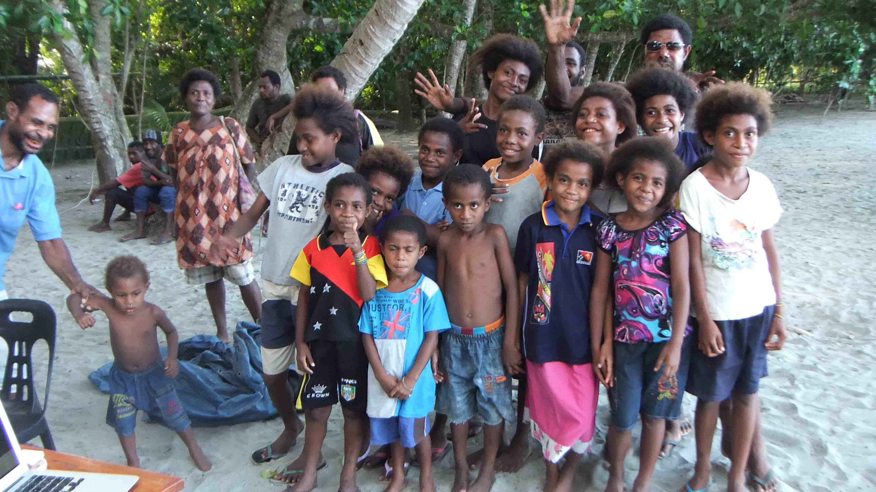
Assessing & Managing
Reef Fish Stocks
Dr Jeremy Prince
Biospherics P/L

Slide 2
The Overfishing Problem
Notes:
We are here to talk to you about the issue of overfishing.
All around the world people have been seeing their fish numbers going down and in some places there are almost no fish left.
But some countries have solved their problem with the fish declining, and now they are getting stronger and stronger again.
So this is what we want to talk about – Overfishing.

Slide 3
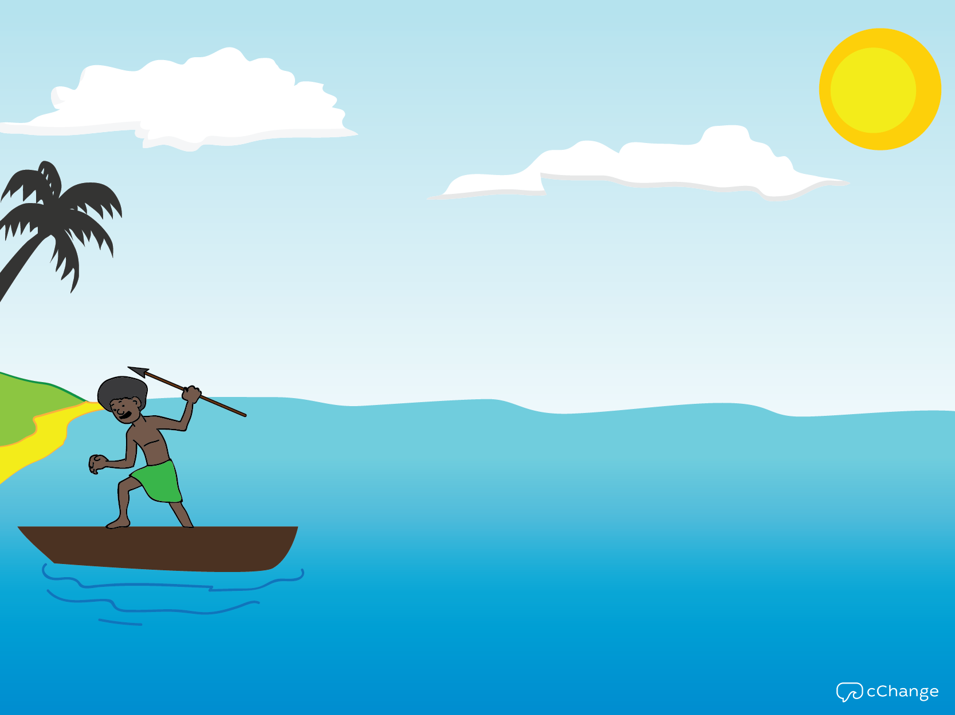

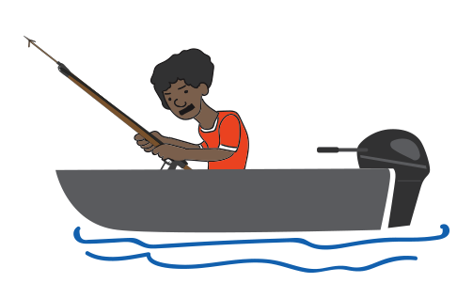
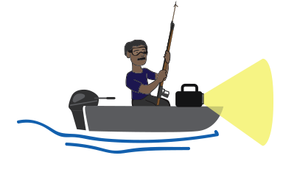
Notes:
And so yes, our fish are getting smaller. It’s also costing us more to catch fish. We are taking longer to catch the same amount of fish we used to catch, and we are having to travel further to catch them. Not too long ago, we could catch fish just off our shores, without the need for a fiber or engine. As time goes on, we are spending more and more on petrol, to catch the same amount of fish. This is because the fish near our shore are being overfished to the point they are no longer producing enough to restock the area. So we are moving to further and further out to find areas that are still healthy.

Slide 4
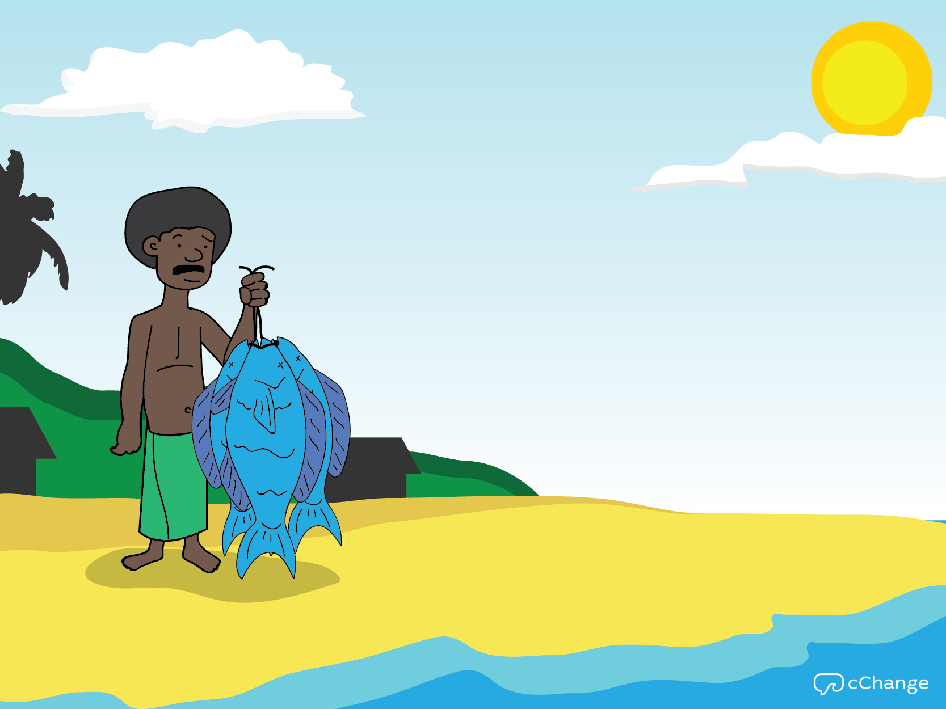
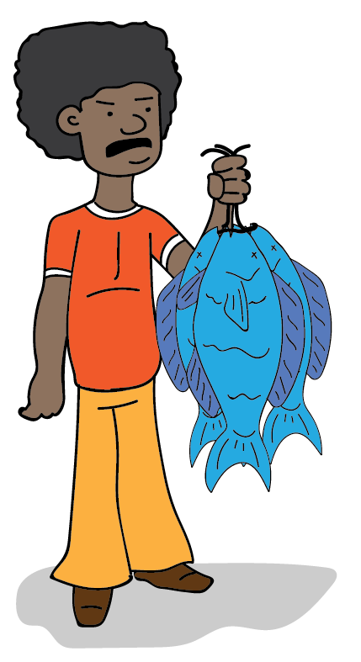
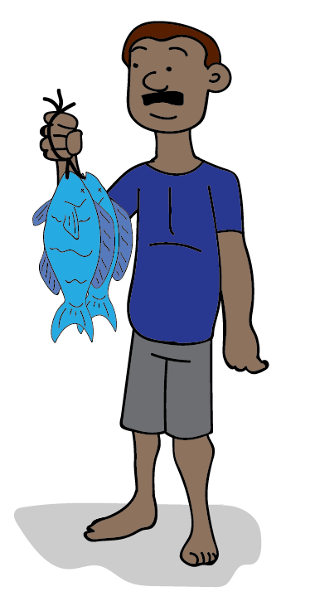
1965
1985
2015
Notes:
Fishermen across Fiji are having a harder and harder time catching fish. This is why we are here today. One of the most telling ways we know this is with our eyes: The fish we are catching are getting smaller and smaller. We are catching fish that are smaller than our father’s did. And far smaller than our grandfather’s did.
People tend to think of the ocean as an endless supply of fish, always there when we need food or income. But the reality is that fishing is getting harder and harder. And it is just not as bountiful as it used to be.
So we are here to talk to you about the issue of overfishing, which means simply that we are taking fish out faster than they can reproduce.
And it’s not just Fiji dealing with this issue. All around the world people have been seeing their fish numbers going down and in some places there are almost no fish left. But some places have also solved this problem of declining fish and now their fish stocks are getting healthier and healthier again and their fish catches bigger and bigger. We want to share ways to help you get bigger and bigger catches.
But before we do we really need to understand the problem.

Slide 5

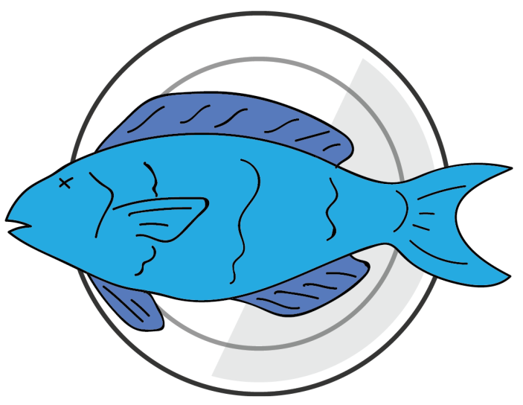
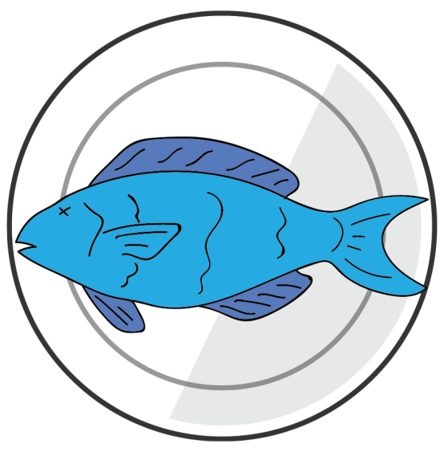
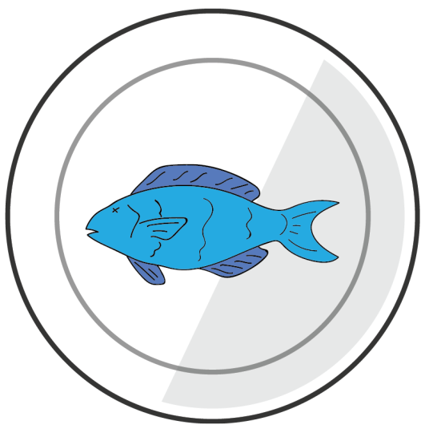

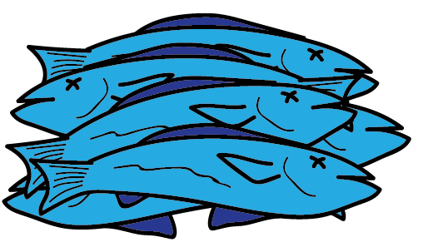
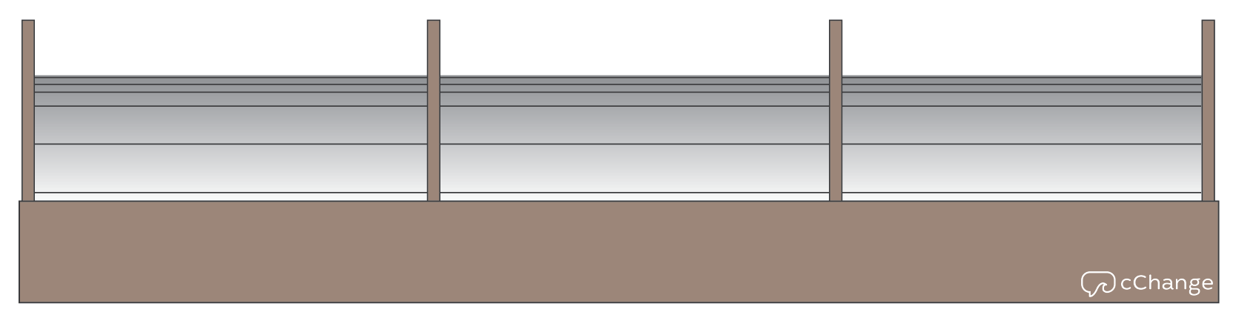
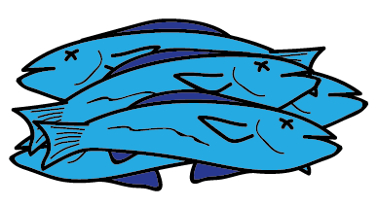
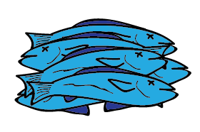
1965
1985
2015
Notes:
And even it’s important say note that if you are not a fishermen, you are likely aware that times have changed and impacted by these changes. The fish on your plates are likely smaller today than there were before. And the fish in the markets are smaller today, than they were before. And often as supplies are reduced, they get more and more expensive. These changes are making life harder for communities in Fiji.

Slide 6
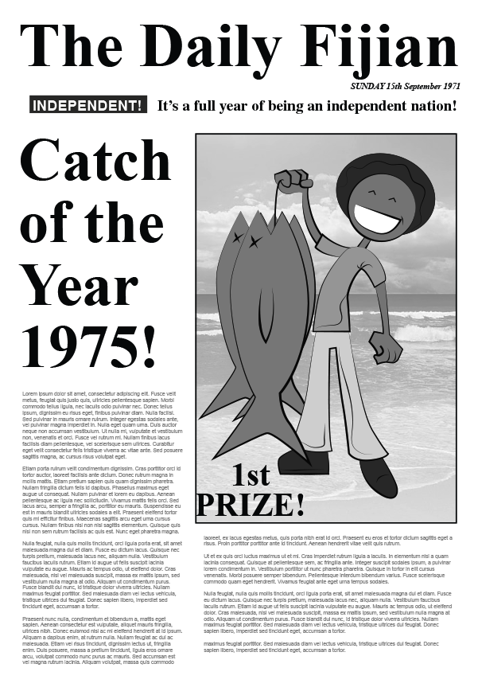
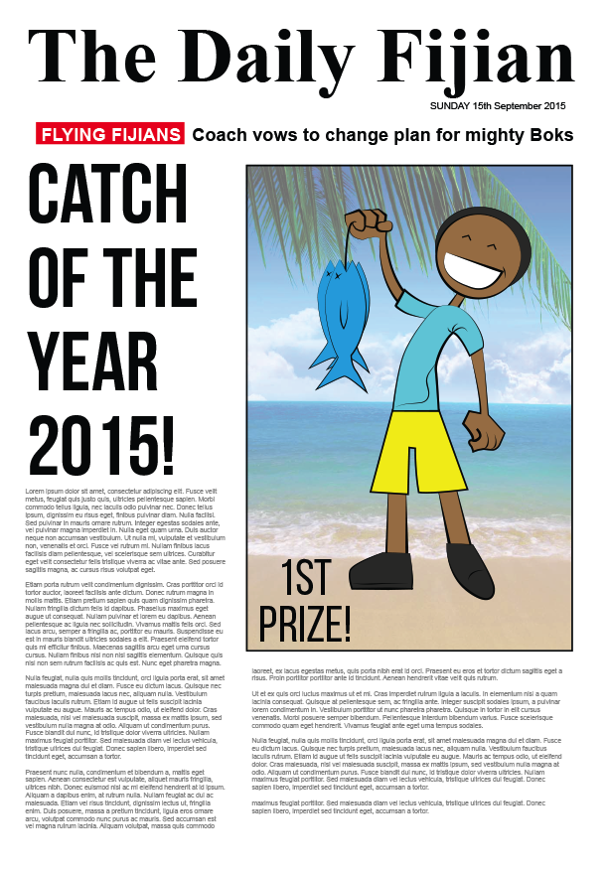
Notes:
Why aren’t people more concerned?
Sometimes, it’s simply because the changes that are taking place in on our reefs are taking place over years, and so people don’t notice how much things have really changed, until they look back over decades and realize that life was a lot better years ago. The fish were a lot bigger, and more plentiful then. But year to year, the change is small enough that people tend to let it slide and just manage life more day to day. This is what scientists call the sliding baseline. Each generation only knows how the fishing was for them and doesn’t realize how much better it was for their parents and grandparents.

Slide 7
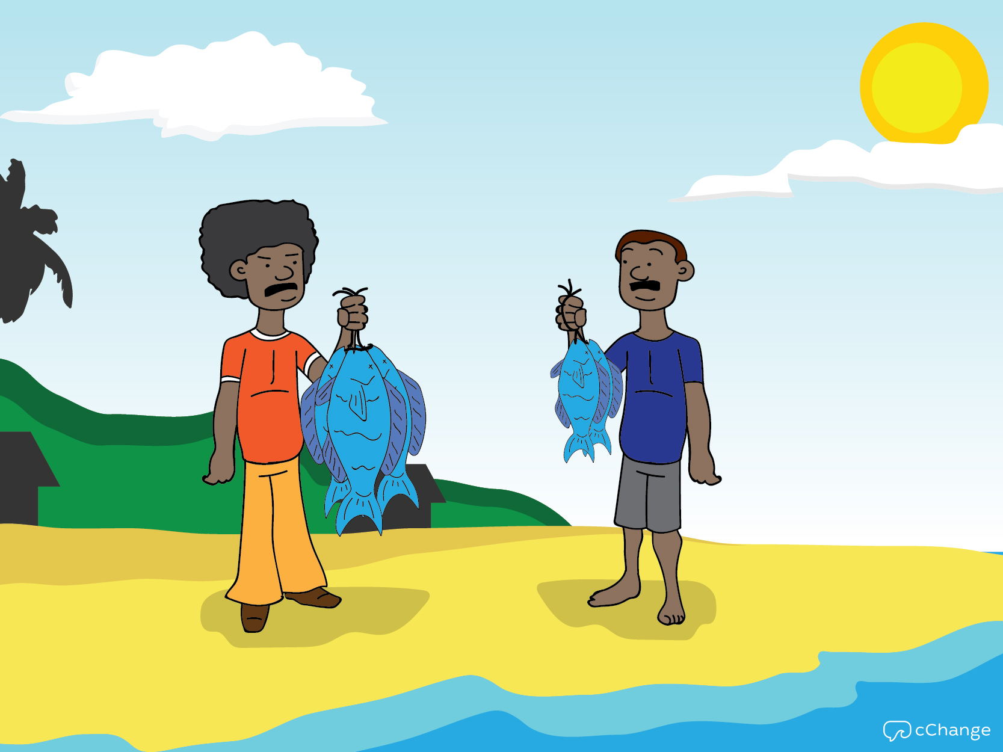
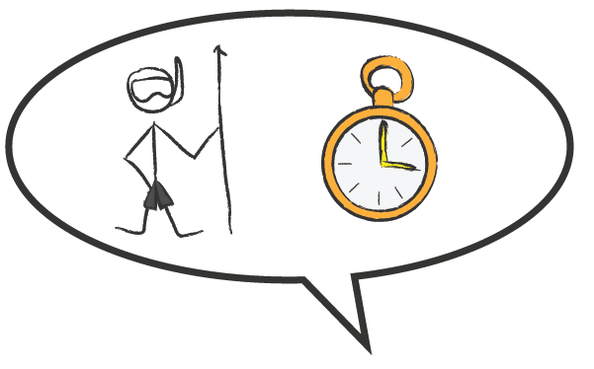
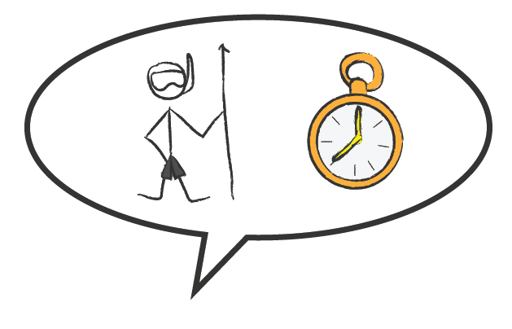
Notes:
So how do you know if your village reefs are being overfished? How do you know if you’re living in a place where things are not as good as they used to be? The easiest thing to do is just ask any fishermen if they are spending more time to catch the same amount of fish. And ask if the fish they are catching are getting smaller and smaller. These are the easiest ways to figure out what’s going on, on your reefs. Most times what we hear is this: It’s getting harder, they are going further, spending more and catching smaller and smaller fish. That’s a trend going in the wrong direction and does not bode well for Fiji communities, unless action is taken, as eventually there will be no fish left to breed.
That’s why we are here to help you take action.

Slide 8
Fishing Down the Food Web
Notes:
The over fishing doesn’t just change how far you need to go to get fish, and the size of the fish you catch, but also you see the types of fish that you can catch changing as well.
This is what we call fishing down the food web.

Slide 9
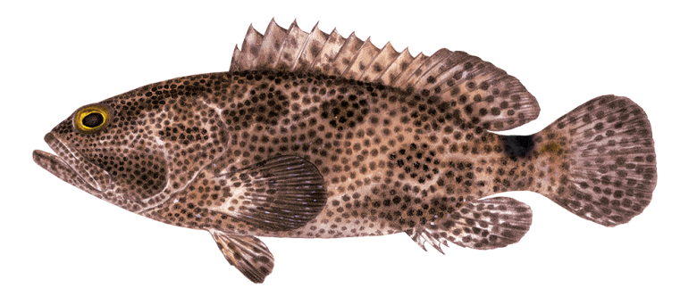
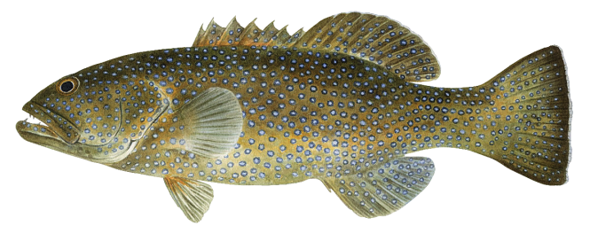
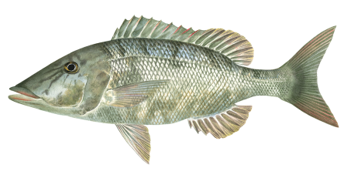
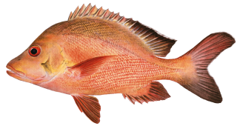
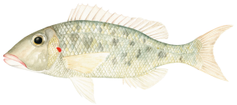

Fishing Down the Food Web
Notes:
On the reef there are many types of fish, with the biggest types of fish eating the middle size fish, the middle size fish eating the smaller fish, and the smaller fish eating the smallest baitfish. This is what scientists call the food web, and it is similar all across the Pacific, with every country starting off with more or less the same types of fish and food web. And in every country as the fishing starts becoming heavy, we see it change in the same way.
The first fish which disappear are always the biggest. Fishermen and hunters always like to catch the biggest fish or animal which will feed the most people in their family and community and give them the biggest bragging rights. And this has been the way since the beginning of time. The first land animals that human hunters killed off were the hairy elephants called mammoths that were once all across Asia, Europe and America until humans arrived and drove them extinct.

Slide 10
Fishing Down the Food Web
Big is Best
Notes:
The next fish to start disappearing are the highly valued species, valued by the market or for customary reasons.

Slide 11
Fishing Down the Food Web
Big is Best
High value – market & culture
Notes:
Then all the most easily caught types of fish start disappearing. The ones that come together seasonally in spawning or feeding large schools, that we learn to take advantage of.

Slide 12
Fishing Down the Food Web
Big is Best
High value – market & culture
Easy to Catch
Notes:
Eventually, where before people mainly fished for the big types of groupers, parrotfish, snappers and wrasse. This type of small red snapper here becomes the most important fish for people. It is small, but forms big schools and aggressively takes the hook.

Slide 13
Fishing Down the Food Web
Big is Best
High value – market & culture
Easy to Catch
Eventually only fish no-one wants are left
Notes:
In time, it too gets fished out and then all that is left are types of fish, that once no-one wanted to eat, fish that before would have been used for bait.
This fish here Lethrinus rubrioperculatus is a small type of emperor which the Palauans call white snapper. Once they tried not to catch this fish, and if some one gave it to you to eat they were insulting you. Once if Palauans started catching this fish they would know they were fishing the wrong spot and would move away to get better fish. But now because the food web in Palau has been fished down so far it is the main thing they catch and sell in the market. If they move away when they start catching this fish, they will end up going home with an empty cooler.

Slide 14
Question & Answers

Slide 15
Serial Depletion

Slide 16
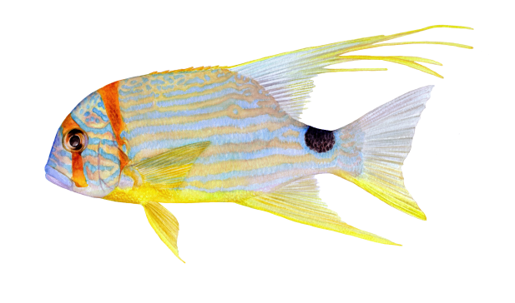
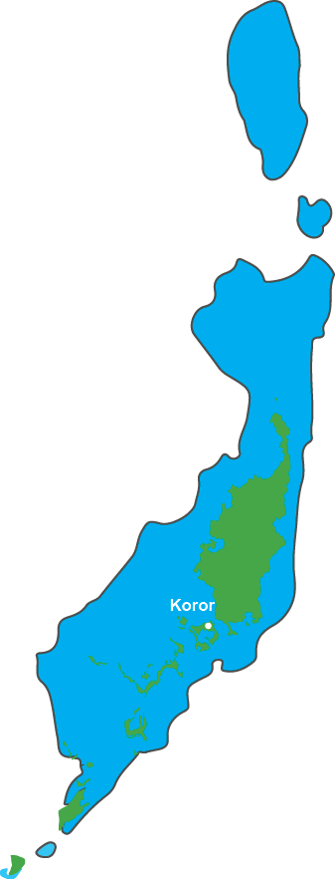
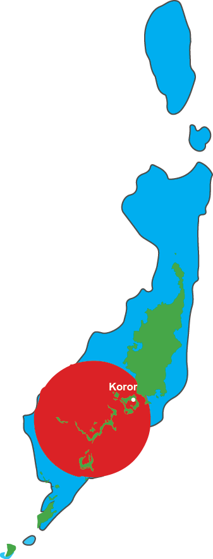
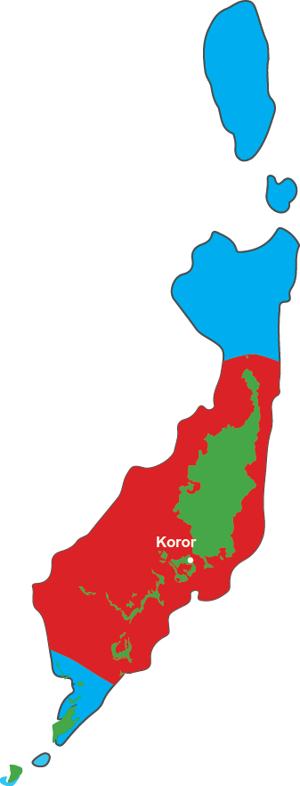
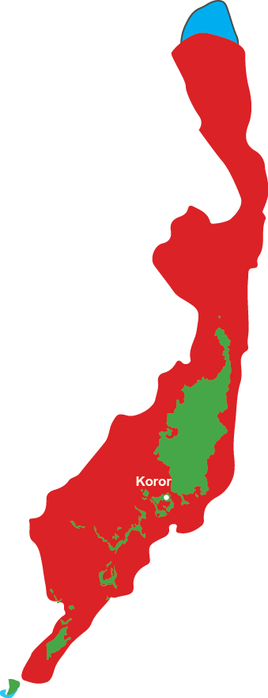
Serial Depletion
1900
1950
1980
2020
Notes:
The fishing down of the food web typically happens in this way: The places closest to the urban centers, and fish markets, see their fish disappear first. Then fishermen go further to catch them and those populations disappear, and they go further and futher.
This is the story of sailfin snapper (Symphorichthys spilurus) in Palau, which is like the Chinaman fish (Symphorichthys nematophorus) in Fiji. Palau is a very small country maybe 100 km from north to south and most of the people live in the capital of Koror. If we go back 80-100 years in the early part of last century this fish was found everywhere and was highly prized everywhere.
But by the 1950s the people in Koror could no longer catch this fish without travelling a long way by boat, To the fishing grounds of the outer communities.
By 1980 people everywhere in Palau were seeing that fish go down in numbers, and it was not being caught anywhere around the main islands and communities.
Today there are only two breeding sites still existing, which are the farthest from the people, in the extreme south and north where no-lives nearby and in deep water with strong currents that make them very hard to fish.

Slide 17
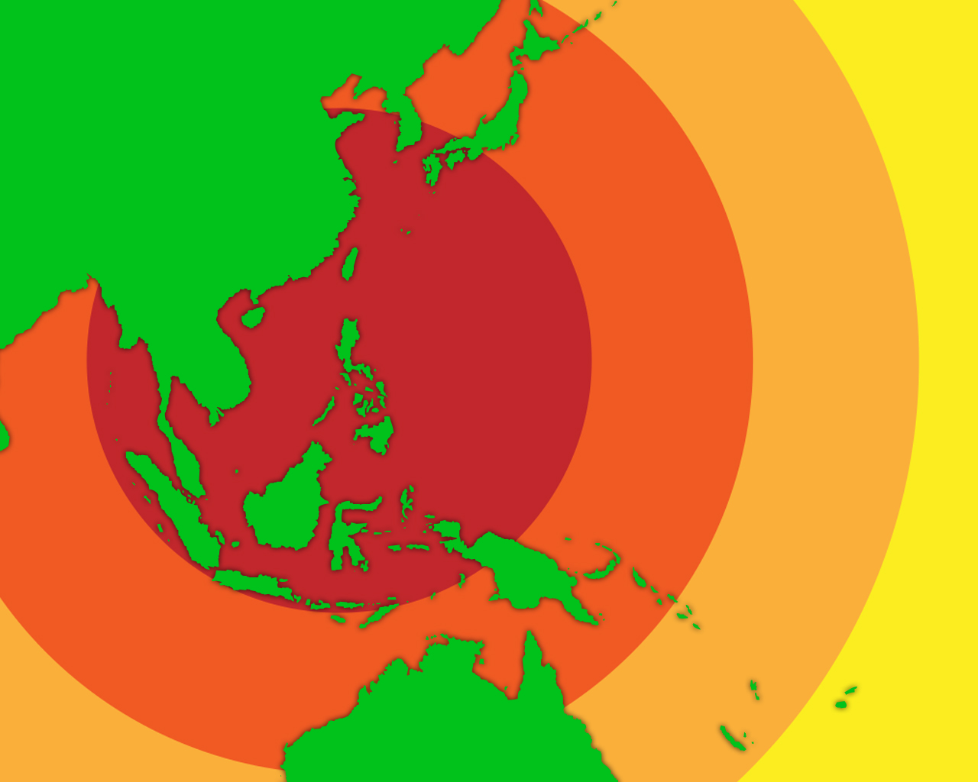
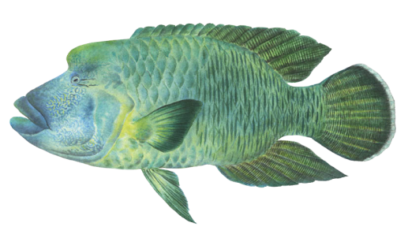

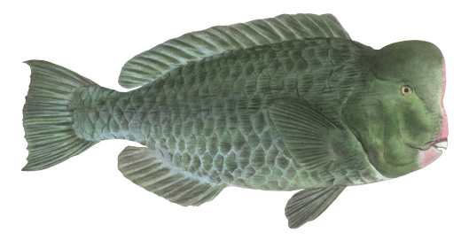
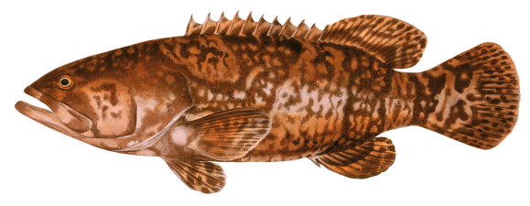
Serial Depletion across the
Western Pacific
Tokyo
Shanghai
Hong Kong
Palau
PNG
Solomons
Fiji
Notes:
This process of overfishing and fish-downing the Food Web is happening right across the pacific ocean now, and every place it happens the same way, although it happens with different timing in each place depending mainly on how many people live in each place and how easy or had it is to get fish to the main markets for these fish.
The biggest fish markets in the world are in Asia in Tokyo, Hong Kong and Shangai. Two thirds of the all the fish caught in the world go into those main Asian markets, and they especially like all this Pacific reef fish, because that used to be their fish as well, but now it is mainly all gone, so now they come to the pacific countries wanting to buy all the fish.
So if you work out how easy or hard it is to send fish from a place to Asia, how many flights and hours of flying it takes for the fish to go from your market to Asia, you can predict what the fish will be like in any place. If it is very difficult and takes a long time to get fish to Asia from a place, then you will see that the fish is better.
The countries close to Asia have already lost almost all of their fish, so in the central Philippines and Western Indonesia where the fish used to be just the same as here, now if a fisherman fishes all day and takes home two small silver fish he will be happy he has had a good day and has some fish to put in the soup for his family that day.
But already these big groupers and the big bumphead parrot fish and humphead wrasse have disappeared or become very rare in most parts of almost all the Pacific countries they were once common throughout, and you must go to very remote areas, or places where they are doing a good job of managing the fish, if you want to see them how they were everywhere once. So now some scientists are saying that by 2040 they think these biggest species will be totally extinct and gone from everywhere forever.
This is a matter of food-security for pacific countries, and also of great cultural importance because of how connected these species are to custom in many countries.
Let me illustrate this by showing you what is happening in two places where this project is also working; in Palau and in Macuata in the north of Fiji.

Slide 18
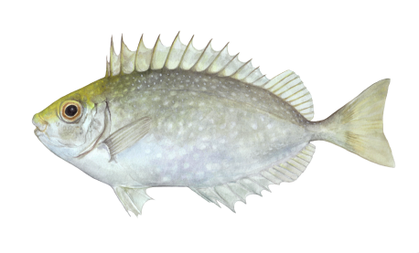

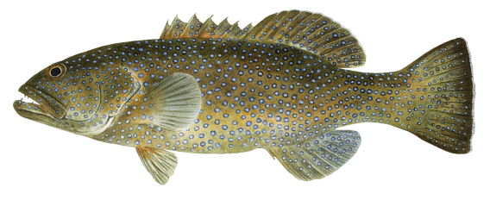
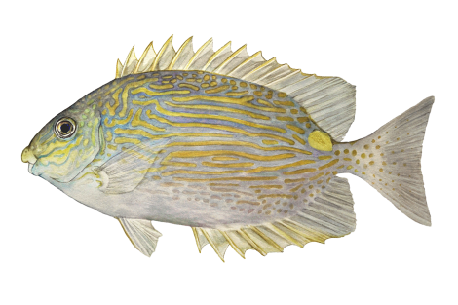
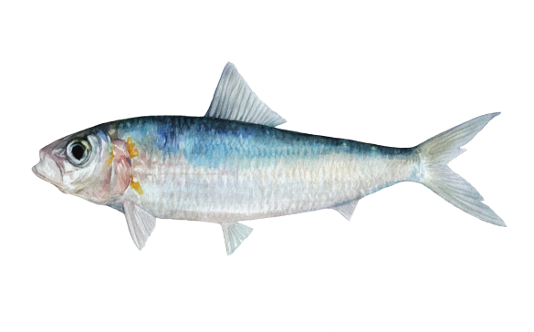
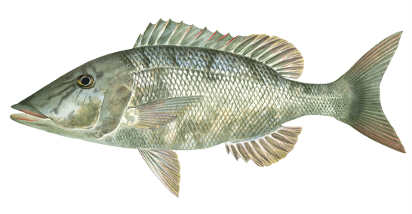

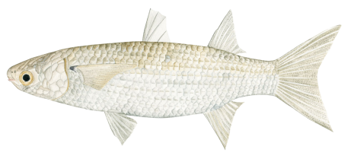
Palau 1970s -10 Species of Greatest Concern
Whitespot Rabbitfish
Groupers
Square Tail Coral Groupers
Longnose Emperor
Lined Rabbitfish
Gold spot herring
Fringelip Mullet
Blue-lined or sail fin sea bream
Notes:
When a marine biologist first went to Palau in the 1970s and began talking with communities like this they told him that these important fish were already in trouble and they were very concerned for the future of these fish. Their type of sail fin snapper, the mullet and gold spot herring, and rabbitfish and long-nose emperor which the nets, that they got first from Japanese people who colonized them, had made easy to catch. And the big groupers species and Bumphead parrtofish and Humphead wrasse which spearfishing and especially spearfishing at night had made easy to catch. These were all in trouble by the 1970s and going down fast.

Slide 19



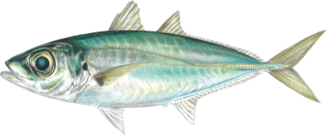

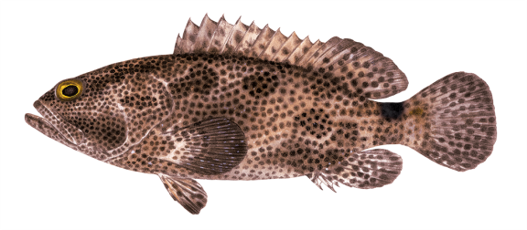




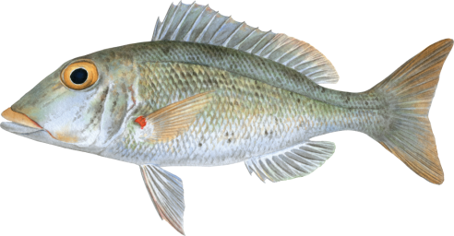
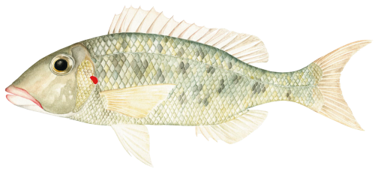
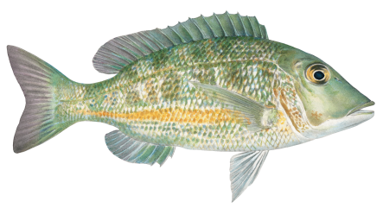
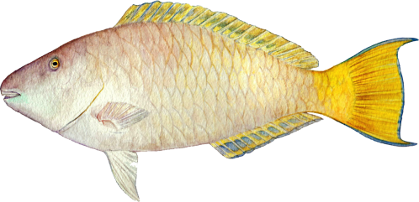

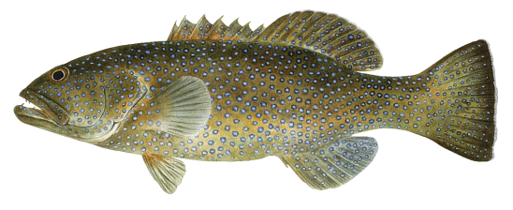
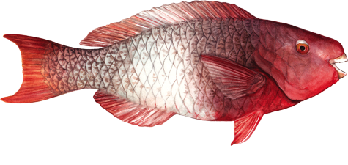

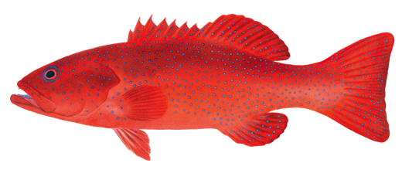
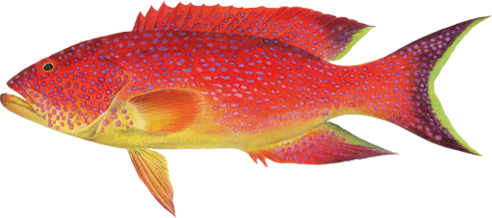
Palau 2015 -10 Main Species Caught in Recent Surveys
Blue-lined or sail fin sea bream
Fringelip Mullet
Gold spot herring
Blacksaddle Coral Grouper
Whitespot Rabbitfish
Groupers
Lined Rabbitfish
Bumphead parrot Fish
Bluespine Unicorn Fish
Hump-head Wrasse
Paddle tail Snapper
Yellowlip Emperor
Longnose Emperor
Square Tail Coral Groupers
Orange Stripe Emperor
Pacific Longnose Parrotfish
Redlip Parrot Fish
Redspot Emperor
Leopard Coral Grouper
Yellow-edge Lyretail Grouper
Notes:
By 2015 when this project did surveys of the catch in Palau, almost none of the fish they were worried about back in 1970 were still important to them.
Of the original larger bodied fish only the long nose emperor was still important but could no longer seen in larger schools, and square tailed grouper, which they banned from catching during the spawning season were still important to them.
Now all the most important fish are the smallest types of grouper parrotfish, snappers and emperors. The small bodied paddletail snapper has been the single most important for many years, and now this is the species most worrying Palauans because they see it getting smaller and harder to catch.
The white snapper (Lethrinus rubrioperculatus - bottom second from the left) is displacing the paddle tail snapper as the most important food fish in terms of quantity, and once the Palauans, didn’t consider this worth catch, in fact if they caught it in a place they knew it was time to move on.

Slide 20
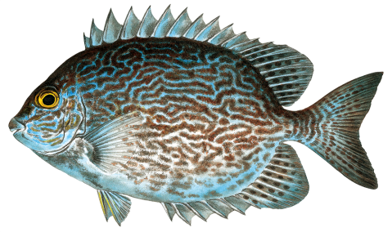









Macuata, Fiji -10 Species of Greatest Concern
Vermiculate Rabbit Fish
Humphead Wrasse
Bumphead Parrot Fish
CUT OUT FISH
Camouflage Grouper
Blacksaddle Coral Grouper
Squaretail Coral Grouper
Diamond Scale Mullet
Gray Drummer
Chinaman Fish
Giant Sweetlip
Notes:
So then when this project goes and talks with communities in Macuata the northern Province of Fiji, what do they see? Fiji is a long way away from Asia, and Macuata is on a different island to Suva the main city of Fiji with the biggest fish market. In 2015 those communities tell us they are worried about almost all the types of fish the Palauans worried about back in 1970.
The chinaman fish, the mullet, and rabbitfish and the big bodied groupers, Bumphead parrotfish and Humphead wrasse which spearfishing and especially spearfishing at night made so easy to catch.
So the question becomes where do you want to end up?

Slide 21

Madang, Papua New Guinea
A Good Catch for One Day of Fishing!
Notes:
This is now a good catch for one day.

Slide 22


Madang, Papua New Guinea
A Good catch for One Day of Fishing!
Notes:
Here is another catch from one fisherman for one day.
In this area the Mangrove Jack – tiri damu is a totemic species and was considered essential for the seasonal feast that was made when young women were initiated.
But it has not been seen or tasted for more than 20 years.

Slide 23
Question & Answers

Slide 24
Why is this Happening Now?
People have been fishing for generations.
Notes:
So people have been fishing here for many generations, and it doesn’t seem like the fishing has changed. You might ask “Why is this happening no?’
There are a few reasons that all this is happening now.

Slide 25

Fiji’s Population Growth
903,664
775,077
588,068
345,737
1956
1976
1996
2014
Notes:
And we also have a lot more mouths to feed than we had in the past. A lot more. We are making more babies and living longer, causing our population to rapidly increase over decades. There means a lot more people eating fish.

Slide 26














Notes:
And today, we are more effective at catching fish.
In the old days, fishermen needed to be experts about each type of fish and how they could be caught when and how to make the right fishing gear out of locally available materials. Hooks were difficult to carve out of bone or shell and mainly fishers used a gorge instead, just a straight piece of bone or shell with a line of natural fibre. In the middle, they would put bait and then by pulling it, try to wedge it in the gills of the fish. But gorges had to be exactly the right size for a fish, or the fish would escape, not like steel hooks we now buy from the shop.
And there were no good nets, so instead of putting a net around a school of fish, coconut leaves were woven together into leaf sweeps and the fish crowded close to shore where they could be speared or scooped up. Most fish would escape by swimming through the leaves. Rabbitfish, for example, live in the seagrass and were not scared of swimming through the leaf sweep so they largely escaped. Spear fishing all occurred from above the water, and to fish at night the moon had to be big, or a burning torch had to be used. Mainly the fishing happened in shallow water, because the natural fibres floated and were not strong enough to fish effectively in deep water outside the reef. So more or less the fishing was mainly for small fish, and once the fish became adult and lived on the outside of the lagoon they were more or less safe from fishing.
But all this has changed in modern times. Modern monofilament nets can be used catch entire schools of breeding rabbit fish, gold-spot herring, mullet and scad. When they come close to shore, almost nothing escapes. And outboard motors let fishers go and fish along way from their village when the have taken all the fish close to home.
Westerners introduced face masks and skin-diving to the Pacific in the early 1900s because they wanted locals to collect pearl shell for them to buy, and after the second world war, modern spearguns became available making it easier to spear the big open mouth XX and parrotfish.
In the 1970s and 1980s, underwater torches started to become available making it easier to spear many types of reef fish while they are asleep in shallow water.
Unlike the original fishing lines which made out of natural fibre and were thick, floated and relatively weak, modern fishing line is very fine and strong, and with modern fishing reels it is possible to fish down hundreds of meters, depths that could not be fished with traditional fishing.
And now technology such as GPS, global positioning system, makes it possible to easily find any good fishing spot. Instead of being an expert fisher yourself, now you just need to know who is the best fisher in a community and follow them with your GPS, and you can steal all the best fishing spots. So now everyone can be an expert fisherman and few fish can escape, where as traditionally only a few could be expert enough and the gear they used always let most of the fish escape. Now the fish have no chance.
All of that means we are taking a lot more fish and there are just a lot less fish being left in the water to reproduce and provide fish for next year.
This is how the world has changed, and why it’s becoming harder and harder to fish.

Slide 27









Notes:
And to address this problem, we need to understand what’s driving these changes. The bottom line is that we are fishing more than ever before. Why? We have more needs than ever before. Our lifestyles have changed as Fiji has developed, and we have gained more access to such things as health care and modern services, and our children have more opportunities for education. That means we need more money than we did in the past, and that means we are fishing a lot more than we once did, for money now, and not just food.

Slide 28








Europe
Asia
Australia
USA
Labasa
Nadi
Suva
Notes:
And some good news, while our needs have increased, we have more opportunities to sell fish and make money than ever before. With the help of ice and refrigerators, and roads and ships and airplanes, and a network of buyers in Fiji and beyond, we can send fish to towns and resorts and to urban areas like Nadi and Suva and to far away markets.
Today, it’s not uncommon to have middlemen come into our communities to buy fish for faraway places.

Slide 29
Question & Answers

Slide 30
Discussion Questions
Which are the types of fish you have seen change the most? Size of fish getting smaller, harder to catch, lower catches, travelling further to catch? (Rank from 1 to 10? 1 being the greatest change.)
If your community was to have a type of fish taken away; which would be the worst to lose? (Rank from 1 to 10? 1 being the worst one to lose)
Notes:
Now is a good time to break into smaller groups and talk about what’s going on in your village. Break into groups of 4 to 6 and answer these questions. We want you to write your answers down on butcher paper and then share back with the larger group, to see where we are today.

Slide 31
Where Are we Going?
Notes:
So the questions each community should be asking is where are we now? How are our fish stocks? And where are we headed?

Slide 32


















Where are we going?
From this?
To this?
To this?
Notes:
Are we here? Still catching good amounts of big groupers and with plenty of Bumphead wrasse, Humphead wrasse, rabbitfish? But even if we still have plenty of these best types of fish are things changing? And how are they changing? Are they changing from this?
Or have we moved on this: Where the best fish are now very hard to find or locally extinct. Are things becoming like Palau, where all the big fish have disappeared, and paddletail snapper are the best fish that can be caught along with medium and small species of emperor and parrotfish.
And will we be able to stabilize the fish at this level, or will it keep getting worse going from this to this, where the reef is almost empty and there are only a few types of small emperor and parrotfish left to catch, and even the paddletail snapper are depleted or gone.
Or will we eventually go from this to …..

Slide 33

Where are we going?
To this?
Notes:
… where communities can no longer feed themselves with fish. But instead have to find a job paying money so that they can buy their families tinned fish.
This is the future that faces every Pacific community if we don’t solve this problem of overfishing.

Slide 34
The Solution to Overfishing
Notes:
So what is the solution to overfishing?
As with most of our environmental problems the solution is for people to change the way they think and behave, and to develop new ways of thinking and behaving.
Pacific people don’t think too much about looking after fish, because th fish are just like air and water. The fish have always been there on the reef and no-one bothers to think about what keeps them there. What sustains the fish? Just like the air and water, which we just breath and drink and take for granted with wondering how it is always there. The fish are the same and we don’t think of them this way.
God will always provide.

Slide 35
Change Old Thinking
Wasting Food
The Small fish are sweetest
Notes:
To the extent we think about fish, we think about not wasting food.
We don’t let the small young fish go, or stop ourselves shooting them, so that they can finish growing and do some breeding.
Instead we think that will be a waste of food. No-one throws good food away, and many people say the smallest fish are the sweetest.
At the moment it just does not make sense to let small fish go because it is wasteful, instead we catch and keep everyone we can. Everything can be used even if it is just for bait.
But we think about the garden in a different way. There is a small child walks around taking the small fruit off the trees before it is ripe, we scold them and tell them not to waste the fruit. In the garden we all know that if we don’t replant with young fruit trees and root crops, plant out seeds, remove weeds, and provide water in the dry times, then the garden will go barren. With the garden we know that we have to look after the young plants or there will be no older plants for us to harvest.
God has provided us with all these plants, but it is still up to us to keep the garden productive.

Slide 36


Suppose you want to farm pigs.
You buy piglets
Notes:
Let me illustrate this point this way.
Here is a pig house that WWF in Fiji helped a community to build because they wanted to fund the community school by growing and selling pigs.
So they went to the market and bought baby pigs – piglets.

Slide 37

Feed them and they grow.
Notes:
Feed them and they grow.

Slide 38

You do not kill and eat all the young pigs.
Notes:
They didn’t kill them all and eat them as young piglets even though they would have been sweet – they wanted a full pig house and productive farm.

Slide 39

Instead you look after them so they give a first litter of piglets.
Notes:
No they kept looking after and feeding the young pigs until they grew to be adults and produced a first litter of piglets.

Slide 40
Two litters.
Notes:
Two litters.

Slide 41
Three litters.
Notes:
Three litters.

Slide 42
Four litters.
Notes:
Four litters.

Slide 43

Then you eat your pig.
Notes:
And then they killed and ate the pig, and it tasted good and was now very big and gave them lots of food, …

Slide 44

And the Pig house is Full
Notes:
And now the pig house was full of pigs they could sell as well.
So this is how we look after gardens – everyone knows this – we call this common sense.
God provides those look after themselves with common-sense.

Slide 45
But this is what we do to the Reef!
Notes:
But we treat the reef differently.
This is what we do to the Reef!
If we can we catch and eat all the fish before they can do any breeding, before they can play their part in keeping the reef full.

Slide 46

But this is what we do to the Reef!
We eat the fish before they breed
Notes:
But this is what we do to the Reef!

Slide 47
The reef is just like the gardens.
Notes:
But the reef is just the same as a garden. It is our garden in the sea. And with all gardens it is true that eventually you reap what you sow. If you don’t look after the garden and replant young plants and look after them, if you eat all the pigs and chickens before they breed, the garden goes barren and the community goes hungry.
And that is what is happening to the reef. The gardens in the sea are going barren because we are not giving the fish enough time to grow to being adults and do enough breeding to keep it full.
We have to start thinking of the reef as our gardens and accept we can’t just take without thinking, we have to give the fish long enough to grow and breed and keep the fish strong and the reef full and productive.
This is the new way to start thinking about the reef if we want to enjoy forever what God has given us in the first place.

Slide 48
The reef is just like the gardens.
Eventually you (cannot) reap what you (did not) sow.
Notes:
But the reef is just the same as a garden. It is our garden in the sea. And with all gardens it is true that eventually you reap what you sow. If you don’t look after the garden and replant young plants and look after them, if you eat all the pigs and chickens before they breed, the garden goes barren and the community goes hungry.
And that is what is happening to the reef. The gardens in the sea are going barren because we are not giving the fish enough time to grow to being adults and do enough breeding to keep it full.
We have to start thinking of the reef as our gardens and accept we can’t just take without thinking, we have to give the fish long enough to grow and breed and keep the fish strong and the reef full and productive.
This is the new way to start thinking about the reef if we want to enjoy forever what God has given us in the first place.

Slide 49
Question & Answers

Slide 50

What can we do?
Notes:
There are a number of management actions that communities have taken to help reverse the decline of their fisheries.
1 Tabu areas.
These are permanent or temporary bans on fishing in an area to allow the fish population to rebuild itself. Ideally the area is left closed permanently and the fish begin to spill over into other areas, and provide a constant source of new fish. If a community does open the area, it is important not to fish it so aggressively that you lose all the benefits you gained by closing it in the first place. For example, some places have fished the area more intensively after the tabu was opened, and while they received an immediate benefit of increased fish, they ended up worse off for the long-term as there were even less fish left after the initial opening to produce future catches. There are also limitations on tabus, as fish, particularly larger ones, that travel outside the tabu, are still vulnerable to overfishing.
2 Gear restrictions.
Some modern gear and fishing methods are so efficient that we can severely overfish an area, so there are not enough fish to produce a healthy amount of fish for the next year. Some gears/methods that other communities have banned for this reason is night-time scuba spear. Other areas have also banned gillnets, particularly ones with small mesh sizes.
3 Seasonal Bans.
This is a ban only on a particular season for a specific season. A good example is protecting the spawning season of kawakawa and donu. By letting them release their eggs before you catch them, you ensure you have enough fish tomorrow.
4 Quotas.
Some communities have found the easiest way to manage a fishery is by limiting the total amount of fish someone can catch. Often the consideration is ensuring everyone first has enough fish to feed their families, and ensuring one person does not jeopardize that by fishing too much for commercial sale one year.
5 Size limits.
Just like humans, fish have to reach a certain age before they can reproduce. This project can pinpoint what size many fish we like need to be to ensure your reefs are plentiful again. If you stop catching fish smaller than that size, or the size were that fish becomes sexually reproductive, you can ensure that some fish are going to reach the stage where they will produce fish for next year.

Slide 51







Notes:
If your fish are not getting big enough to reproduce before you catch them, they won’t have a chance to reproduce and replenish our seas. That’s the heart of the overfishing issue and a big reason why fish stocks decline.
We are catching fish before they get a chance to reproduce. This path could eventually lead to the fishery collapsing, as not enough fish are left to breed and restock your fishing grounds.
We are letting our fish get big enough that enough of them are reproducing each year to restock our fishing grounds.

Slide 52
How Much Breeding is Enough?
Notes:
So this leads us on to thinking about how much breeding is enough and how can we know how much is happening now, and how can we make sure that there will be enough in the future.

Slide 53








Human Populations
Average maximum of 10 Children per couple
Population
Growth
More than 2 Children per couple
2 Children per couple
Population Stable
Replacement Level
Less than 2 Children per couple
Population
Decline
Notes:
So this is easiest to explain by thinking first about human.
We now that is we do a survey of a community and find that on average each adult couple has about two children grow up to adults, then the children will replace the adults and the population will be stable. This is what we call the replacement level of breeding. This level of breeding is enough to replace the existing adults.
If on average each adult couple has more than 2 children than the population will grow, and the larger the number is the faster it will grow. So in many Pacific countries couples have four or more children on average and the populations are doubling every 30-40 years.
On the other hand in many countries in Europe, in japan and China couples have on average 1.2 – 1.5 children per couple and without immigration thei populations are now getting smaller and smaller.

Slide 54







Spawning of Fish
No Fishing = 100 % spawning fish
More than 20% Spawning fish
Population
Growth
20% Spawning fish
Population Stable
Replacement Level
Less than 20% Spawning fish
Population
Decline
Notes:
So we can think about the reef fish in the similar way.
If there is no fishing, before the forefathers came to these islands and started fishing, all the fish got to live out their natural lives and do 100% of their natural amount of breeding, which in fish we call spawning. So without fishing the fish get to complete 100% of their potential for spawning.
And when people start fishing many of the fish get caught and eaten before they can complete 100% of the natural potential for spawning, because their lives are cut short when we catch them.
From studies down around the world Marine Biologists know that down to around 20% of the natural potential for spawning the fish can still build their population and keep the reef full, but the lower the number the slower the longer the population takes to build back up again after fishing.
Around 20% of spawning the adult fish can only do enough breeding to replace themselves and keep the population steady at the low level, but they can no longer grow their population and fill a reef back up again, so this 20% of spawning is like each human couple having 2 children. This is the replacement level for fish populations.
Below that level the adult fish cannot complete enough of their potential for spawning to even replace themselves, and we expect that year by year the population of fish will get less and less as we catch and eat them before they replace themselves. And eventually the fish will go locally extinct and the reef will go barren.

Slide 55
Fishing changes the size of the fish we see on the reef
Notes:
We can now find out how much spawning the fish on any reef are getting done by studying the size of fish on a reef and the size at which they start breeding.
This project uses the fact that fishing changes the size of fish in predictable way that scientist understand very well.

Slide 56












Size of Maturity
Notes:
So this the type of graph we use to make this study to work out how much spawning is happening on a reef. On the bottom we show the length of the fish, the smallest fish on the left and the biggest fish on the right. Up the side we show the number of fish of each size that that we count, from few fish (zero) at the bottom up to many fish (450) fish of a size at the top. And here we also show the size at which the fish mature – become adults.
Now we show the sizes of the fish that we would see if there was no fishing. In this picture we see in our sample that we have measured about 425 fish of size 20, but we measure zero fish of size 30 & 32. That is because like humans every fish has an average adult size and a maximum adult size, and even if there is no-one fishing they stop growing and die-off before getting above that maximum size which in this picture is about 29. On the other hand normally we don’t see the smallest fish in our samples because they are not caught by the fishing gear, either because the hooks or nets are too big, or because many small fish hide away in the coral, or seagrass or shallows to stay safe from being eaten by the big adult fish out on the reef.
So when fishing starts some of the fish get caught and eaten before they can grow to full size and old age
And as fishing gets heavier more fish are caught before reaching full size, and this has the biggest effect over on the right and in the middle of this graph where you see there are now a lot less of the biggest size classes of fish. And see the way the average size of the fish is getting smaller, so that it looks as if the fish are now smaller over all. This is not because the fish are growing any differently, it is just because the fish don’t get to live as long as before, or grow as big; most of them are now being caught before they get big and old.
This process goes on the longer there is fishing and the more fishing that occurs. Until eventually no fish ever get as big as they used to in the past. This is what often creates arguments in fishing communities between the old fishers who remember catching much bigger fish, and the young fishers who have never seen fish that big and think the old fishermen are exaggerating about the size of the fish the old people used to catch. But over on the left, the young small fish remain much the same as long as there is at least 20% of spawning going on, enough to keep the supply of young fish steady.
So as long as there is enough spawning almost all the change will be in the number and size of the biggest fish.
But eventually when the level of spawning goes below 20%, the supply of little fish starts failing and then you see change on the left as well, with the last lot of fish growing bigger and getting fewer and fewer,
Until at last they are caught out and the population goes local extinct.

Slide 57

Size of Maturity
20% Spawning
Notes:
So our method uses the way fishing changes the size of fish to estimate how much spawning is occurring now. If we measure the size of fish now, by knowing what type of fish we are looking at and measuring the size at which it becomes adult in each place we can estimate how much spawning is being left by the fishing in each place.
And what we know is this: as long as there is enough breeding the population will be steady, with enough new fish every year coming back. To keep the stock strong and the reef full we need 30-40%b but as long as we have at minimum 20 percent of spawning the stocks will stay stable if not plentiful.
So the goal of this project to figure out how much spawning is happening now, and what the size should be to make sure more than 20% of spawning is safe. If we protect the fish until they have done the bare minimum of 20% spawning it also happens to make sure that maximum amount of catch can be made, because the fish will get to the best possible size.
This like stopping people eat all the fruit on a tree before it becomes big and ripe – so away of making more food – instead of catching the fish too small before they have grown up.

Slide 58
Question & Answers

Slide 59
Community Science
Data Gathering

Slide 60


Set Size data:
What we need to know
Catch lengths
Size of Maturity
Notes:
So these are the types of measurements we have been making.
On the left you see a fish being measured for length on a measuring board, and on the right you see a fish cut-open so we can see if is adult or immature, and whether it is male or female.
With just these two data measurements, we can figure out your 20 percent, or what we call Set Size.

Slide 61


Measuring the Length of Fish:
Measure along the Middle of Fish
Notes:
Measuring fish for length is very easy. We just how many millimeters long they are by measuring from the tip of their nose down the middle of their bodies to the middle of their tails.

Slide 62
Rules for Measuring the Length of fish.
Measure down the middle of the side of the fish from tip of snout to tip of the middle of the tail.
It is not necessary to measure every species on the list, so choose which species you intend to measure.
It is not necessary to measure the length of the chosen types of fish in every catch.
But ….when you choose to measure fish of a type from a catch, you must finish measuring every one of the chosen type from the catch you have chosen to measure.
Do not choose only some of the selected type of fish to measure because you will Unconsciously choose only some size of fish.

Slide 63









Size of Maturity
Immature
Mature Male
Mature Female
Notes:
The second bit of information we get is about whether the fish is adult or immature, and male or female. This is a bit more difficult and takes a while to get your head wrapped around, especially when the fish are not in their season for breeding.
So for this we need to cut the belly of a fish open. So here we are holding a fish on its back and we have opened up its belly. Now the stomach and liver what we call the guts are on top and we can pull them forward to look beneath for the sex organ or gonads. If there are gonads there are always two of them, sitting next to the air bag or swim bladder up against the backbone of the fish.
Before the fish starts becoming an adult, when it is still immature, on the left here, it may be impossible to find the gonads because they have not even started growing yet. If you cannot find the gonad in a fish, just assume that it is immature. Eventually as the fish starts to become adult - two little clear threads or straps will be seen, in the middle at the left, and eventually the strings start filling up to become like a small tube or sausage.
When the fish are adult the gonads have a distinctive shape and color, but whether they are big or small depends on whether they are in their spawning season, or between the breeding seasons.
The gonad of the adult males, in the middle here, are normally a milky or creamy color, and has a shape a little bit like a liver with lobes, Sometimes fish have a lot of fat or grease that can look a bit like the male gonad, but normally that will be wrapped around the stomach and not lying as a pair along the back bone. Also it feels different to the gonad – greasy and oliy, not just slimy like the gonad.
The adult females (on the right) are normally orange or brown but in some fish can be a light brown creamy color as well. But they start off like tubes or sausages, and as they grow the veins supply nutrients to grow the eggs become visible and if you break them open you will feel they are gritty inside – which is the little eggs.
As the time for breeding gets close, the gonad get big and fill the gut cavity, th female gonad breaks open easily and the eggs are clearly visible, and the milky milt of the male comes out easily.
When the fish are breeding it is often not necessary to cut the fish open, you can just squeeze their fat bellies and see if eggs or the male milt comes out, to see which sex they are.

Slide 64
Rules for Categorising the Maturity of fish.
Use the Categorisation Notes.
It is OK to choose some fish out of a catch to categorize for maturity.
It is not necessary to categorize fish from every catch.
It is not necessary to categorize every species on the list, or every fish of the species you have chosen to measure for length. It is OK to categorise just some fish.
With many immature fish (I) it will not be possible to know if they are male or female; leave that column blank unless you a certain that an immature fish is male (M) or Female (F).
It should be possible for all Adult (A) fish to be categorised as male (M) or Female (F).

Slide 65
Filling the SPR Form

Slide 66

The End
Jeremy Prince biospherics@ozemail.com.au

